Slide 1
Digital Signal Processing
Dr. Michael Nasief

Slide 2
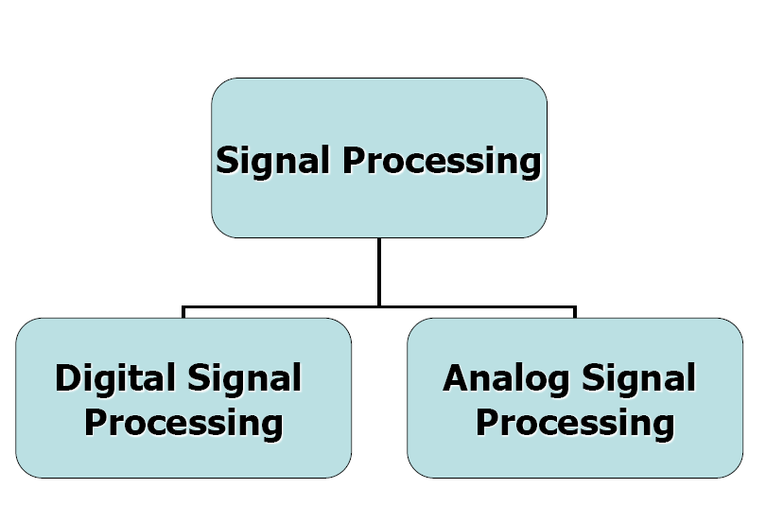

Slide 3
What is Digital Signal Processing?
Digital: operating by the use of discrete signals to represent data in the form of numbers
Signal: a parameter (electrical quantity or effect) that can be varied in such a way as to convey information
Processing: a series operations performed according to programmed instructions

Slide 4
The Breadth and Depth of DSP
Digital Signal Processing is one of the most powerful technologies that will shape science and engineering in the twenty-first century. Revolutionary changes have already been made in a broad range of fields

Slide 5
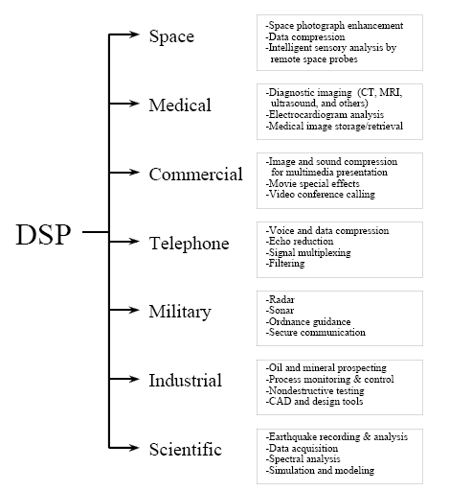

Slide 6
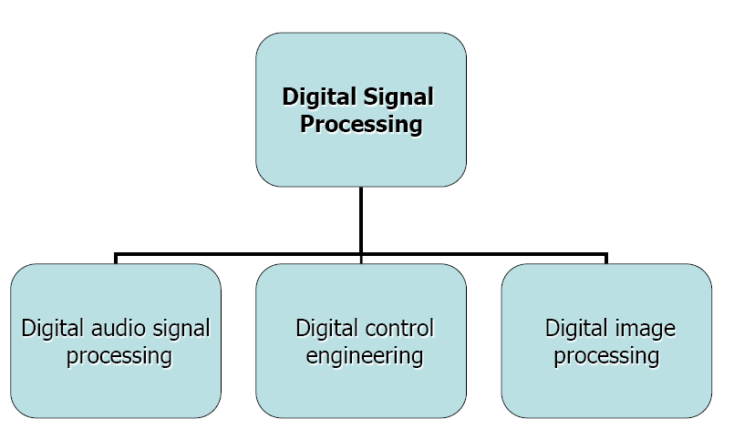

Slide 7
Note

Slide 8
Teaching Methods for DSP
Simple Lecture Only
Integrated Lecture and laboratory.
Computer based explanation.
DSP
Lec
Sec.
Theory.
Practical.
Problems.

Slide 9
Theory
Foundations.
Discrete Signals.
Periodicity.
Fundamentals.
Convolution.
DFT.
FFT.
Z Transform.
Filter Design.
Applications.
Audio Processing.
Image Processing.

Slide 10
References
J.G. Proakis and D.G. Manolakis, Digital Signal Processing 3rd edition, Prentice-Hall.
Schaum's Outline of Theory and Problems of Digital Signal Processing Monson H. Hayes
R.G Lyons, Understanding Digital Signal processing, 2nd edition, Prentice-Hall.
The Scientist and Engineer's Guide to Digital Signal Processing, W. Smith

Slide 11
Practical
Matlab Functions.
Data acquisition card and LabView.

Slide 23
Assignment (1)
Compare Between:
Microcontroller.
Microprocessor.
DSP.
FPGA.

